Slide 1
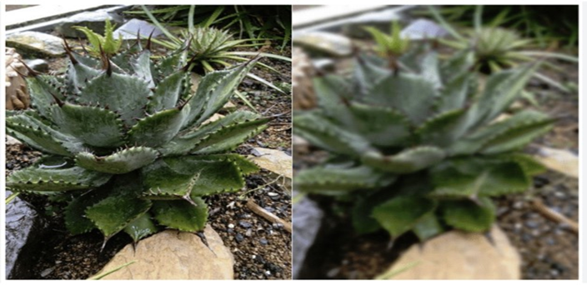
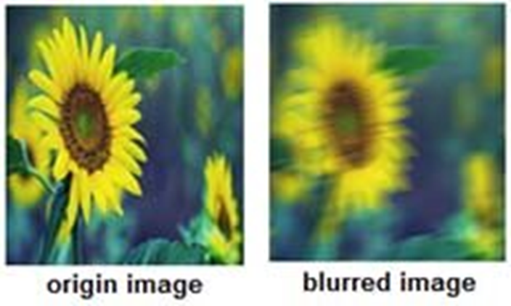
Image Blur vs. Sharp Classification Using Traditional Neural Networks
Members:
Nada Alaklook 220222591
Salma Abu Hujair 220222331
Aya Abu Jamea 220220967
Course Name: Digital image processing.
Dr. Mohamed Alsheakhali

Slide 2
Theoretical part
Introduction to Neural Networks (NNs)
Core Concept: Brain-inspired computational models used in machine learning to recognize patterns and make decisions.
Biological Inspiration: They attempt to create machines that work similarly to the human brain by using components that behave like biological neurons.
Project Specifics: This project utilizes a traditional Multi-layer Perceptron (MLP) to classify images as "blurred" or "sharp" based on extracted features.
Key Benefits: These networks offer adaptability, parallel processing capabilities, and fault tolerance.

Slide 3
Network Architecture & Learning Mechanism
1. The Layer Hierarchy (Structure):
Input Layer: Receives the 44 extracted features from the dataset and passes them forward without computation.
Hidden Layers: The "processing engine" where core computations occur. They learn abstract relationships and extract "hidden" features from the data.
Output Layer: The final stage that provides the prediction (Classifying the image as Sharp or Blurred).
2. The Mechanics of Learning (Process):
Mathematical Foundation: Each neuron operates based on the weighted sum: Y = Σ(weight * input) + bias
Three-Stage Learning Cycle:
Computation: Data is introduced into the system.
Generation: The network produces an output based on current parameters.
Refinement: The model improves performance by iteratively adjusting Weights and Biases to minimize error.

Slide 4
Structural Components of the MLP
Neurons & Connections: Neurons are the basic processing units that apply activation functions.
Connections transfer signals between layers.
Weights (Importance):
Numerical values that determine the influence of each input feature.
Higher weights indicate more significant features for blur detection.
Biases (Flexibility):
An additional parameter used to adjust the output along with the weighted sum.
Enables the model to make decisions even when input values are zero.
Learning Rules (Optimization):
The mechanism for updating weights using Backpropagation.
Ensures the model minimizes error and improves accuracy over time.

Slide 5
Comparison: MLP vs. CNN
Traditional (MLP):
Feedforward networks with no memory; they treat each input independently.
Rely on handcrafted features provided by the user.
Best for structured data (e.g., house prices) and are computationally lightweight.
Convolutional (CNN):
Designed for grid-like data like images and videos.
Use convolutional and pooling layers to automatically extract features like edges and textures.
Highly effective for complex visual tasks like object detection.

Slide 6
Activation Functions & Optimization
Activation Functions: These introduce non-linearity, allowing the model to represent complex data; without them, the network acts like a simple linear regression.
ReLU: Used in hidden layers for faster training and better gradient flow.
Sigmoid: Used in the output layer for binary classification to provide a probability between 0 and 1.
Optimizers: Algorithms that change weights to minimize the Loss Function.
SGD: Efficient for large datasets by updating weights one training example at a time.
Adam: Combines momentum and RMSProp to provide adaptive learning rates for each parameter, accelerating convergence.

Slide 7
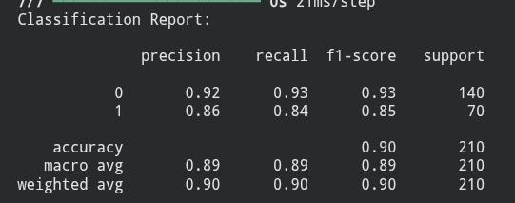
Practical Part
Part 1: Single Dataset | 6 Features
Objective: Baseline image blur classification using core statistical and texture features.
Dataset: Blur Dataset (Kaggle) – includes Sharp, Motion Blur, and Defocused images (Total: 1050 images).
Feature Extraction (6 Features):
LBP Mean: Captured basic texture patterns.
Statistical: Entropy (randomness), Skewness, and Kurtosis (intensity distribution).
Clarity: Laplacian Variance to measure edge sharpness.
Model: Multi-Layer Perceptron (MLP) Classifier using Keras/TensorFlow with Adam optimizer.
Results:
Overall Accuracy: 90%.
Note: The model shows high precision for Class 0 (0.92); however, Class 1 has slightly lower recall (0.84), suggesting some motion/defocused images are still being misclassified as sharp.
LINK : MODEL1

Slide 8
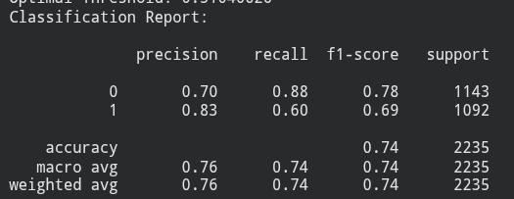
Part 2: Two Datasets | 9 Features
Objective: Improving model robustness by integrating multiple data sources.
Datasets: Combined Blur Dataset + Ki Dataset to increase sample size and diversity.
Feature Extraction (9 Features):
Refined Clarity Algorithms to detect fine detail visibility.
Advanced Statistical Measures (Entropy, Skewness, Kurtosis).
Model: MLPClassifier with an Integration Strategy (merging train/test sets from both sources to create a larger training base).
Results:
Overall Accuracy: 74% (Significant jump from initial 46%–50%).
F1-Score: 0.78 (Sharp) / 0.69 (Unclear).
LINK : MODEL2

Slide 9
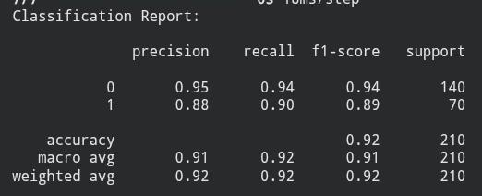
Part 3: Single Dataset | 45 Features
Objective: Achieving high-precision classification using a traditional neural network with advanced feature extraction
Dataset: Blur Dataset (1,050 samples) with high-dimensional feature integration.
Feature Extraction (45 Features):
Texture & Pattern Analysis: LBP Histogram and Hit-or-Miss.
Frequency & Gradient Analysis: FFT and Tenengrad (Mean, Variance).
Statistical Measures: Entropy, Skewness, Kurtosis, and Standard Deviation.
Structural Analysis: Laplacian Variance, Morphological Features, and Wavelet Features.
Model: Neural Network (TensorFlow/Keras) featuring Batch Normalization and Dropout layers to prevent overfitting.
Results: Overall Accuracy: 92%. || F1-Score: Sharp (Category 0): 0.94 , Blure(Category 1): 0.89
LINK : MODEL3

Slide 10
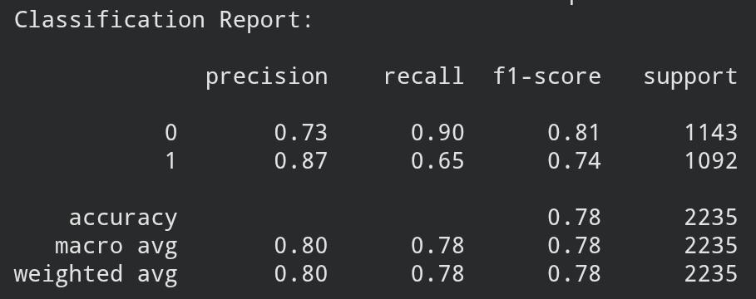
Part 4: Two Dataset | 44 Features
Dataset: Combined Blur Dataset & KADID-10K
(11,175 samples) with high-dimensional feature integration.
Feature Extraction (44 Features):
Texture & Pattern Analysis: LBP Histogram.
Frequency & Gradient Analysis: FFT (Mean), Tenengrad (Mean, Variance), and Laplacian Variance.
Statistical Measures: Entropy, Skewness, Kurtosis, and Standard Deviation.
Structural Analysis: Hit-or-Miss, Morphological (Open, Close, Tophat, Blackhat), and Wavelet Features.
Model: Neural Network (TensorFlow/Keras) featuring Batch Normalization and Dropout layers to prevent overfitting.
Results:Overall Accuracy: 78% || F1-Score: Sharp (Category 0): 0.81 , Blur (Category 1): 0.74
LINK : MODEL4

Slide 11
demo
demo link

